Slide 1
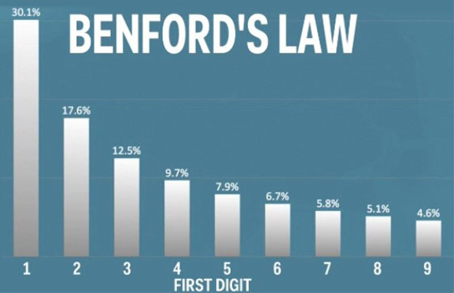

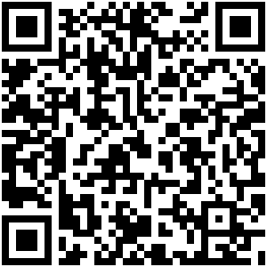
Benford’s Law Natali Djavarov Dor Yaakobi Koren Levi Supervisor: Prof. Vadim Levit
The objective of the project is to examine Benford's Law within datasets that represent election campaigns, with the aim of drawing new insights and making conclusions about the application of Benford's Law in this context.
2. Benford’s Law, also known as the first-digit law, is an observation that in many real-life sets of numerical data, the leading digit is likely to be small. In sets that obey the law, the number 1 appears as the leading significant digit about 30% of the time, while 9 appears as the leading significant digit less than 5% of the time. Benford’s Law is often used as a tool for detecting anomalies or fraud in datasets, as deviations from the expected distribution can indicate potential irregularities.
3. The election simulator is a tool that runs simulations of election scenarios involving two or more candidates.
It takes input data, specifically the votes obtained in each ward, and generates the Benford's Law distribution for each candidate.
This tool allows us to analyze the Benford's Law distributions across a wide range of election scenarios.
4. The simulator utilizes data from various wards, comprising their sizes (indicating the number of assigned citizens) and the actual election outcomes. Each ward's result represents a data unit for every candidate, which is incorporated into the final dataset to determine the distribution in accordance with Benford’s Law.
5. The simulator findings show us the distribution over each candidate, here is the findings of an election scenario which represents the 2020 election at Milwaukee(US) in which Joe Baiden had 70% support and Donald Trump had 30% support.
As shown in the above figure, Trump’s distribution is more likely to follow Benford’s Law distribution than Baiden’s distribution. We are claiming that there were approximately 1000 voters in each ward to cause this kind of distribution for both candidates. Baiden had 70% of total votes, therefore, his leading digits were 4,5,6 (besides 1), on the other hand, Trump had 30% of total votes, therefore, his leading digits were 1,2,3 (similar to Benford).
Scan QRCode for full Instructions
Visit Us

